Slide 1
TG3 – Use Case Library
Tasked to assemble a library of use cases describing specific examples of data selection
How to document use cases?
Why collecting use cases?

Slide 2
Why collect use cases
To build a use case library as a resource to research how data is selected for particular purposes
Allow reuse of use cases for consistent quality assessment
To build profiles of the most used information elements, dimensions and criteria and feed these back into the development of data capture and quality assessment tools
Begin to develop automated data selection for use cases

Slide 3
Documenting Use Cases
Use the framework from TG1 to develop a use case description store – a series of related worksheets to capture a use case as usable data.
From this point it has been a process of iterating over use case description mechanisms to try and reach a usable tool
Spreadsheet file
Google form for User Stories

Slide 4
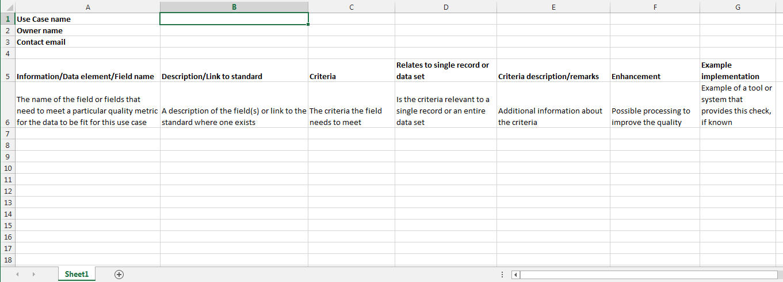
Offline worksheet

Slide 5
Participation
Participation was … limited
Detailed spreadsheets are difficult to use
The simpler data capture gets the more work it takes to turn it into usable data
Was going to need some dedicated effort

Slide 6
Summer of Use Cases
To put some dedicated resources to the project Emily Rees (ANU engineering undergraduate) was brought on for the CSIRO summer scholarship program to chase documenting use cases
3 months work documenting use cases from
Research papers
Individual interviews
Encouraging use of the Google form
Produced a Use Case Library and analysis
Around 30 use cases documented

Slide 7
What’s next?
For discussion this afternoon:
Continuing to populate the library?
Use of the library?
Knowledge gained?

Slide 8
Data mining from Mendelay library
Data mining from download queries (don’t know purpose)
Better controls on a simple google form (checkboxes and drop downs rather than text)
Build a profile library rather then documenting use cases
When someone does a download can they register their profile and get a DOI?
Follow up with a post download profile?

Slide 9
Nested quality profiles – levels of quality compliance
Gold, silver bronze std

